Slide 1
Oversight Hearing on Homelessness
Sharon Rapport, Corporation for Supportive Housing

Slide 2
CSH Advances Housing Solutions That—
Improve lives of vulnerable people
Maximize public resources
Build strong, healthy communities
Notes:
Sharon
CSH is the national champion for supportive housing, demonstrating its potential to improve the lives of very vulnerable individuals and families by helping communities create over 335,000 real homes for people who desperately need them. CSH funding, expertise and advocacy have provided nearly $1 billion in direct loans and grants for supportive housing across the country. Building on nearly 30 years of success developing multi and cross-sector partnerships, CSH engages broader systems to fully invest in solutions that drive equity, help people thrive, and harness data to generate concrete and sustainable results. By aligning affordable housing with services and other sectors, CSH helps communities move away from crisis, optimize their public resources, and ensure a better future for everyone.

Slide 3
State Role in Solving Homelessness: Help Californians Move into Permanent Housing
Make Up Gap in Affordable Housing
Fund Rental Assistance
Use Medi-Cal Benefit to Pay for Housing-Based Services

Slide 4
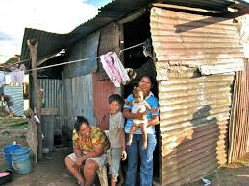
Tiny Homes, Sheds, Decreased Housing Standards are Not Permanent Housing
Substandard housing: Risk factor for homelessness

Slide 5
Ways to Fund Housing
Rental Assistance: Private-market landlords
Housing authority or intermediary pays landlords
Service providers offer services to tenants in or near housing
Incentives to landlords
Capital: Loan/tax credits to developers
Capital subsidies to developers to build apartments
Operating subsidies to operate building
Service providers offer services to tenants promoting housing stability in apartment

Slide 6
Need Medi-Cal Benefit to Fund Services
100% California-Funded
Services funded by local & state mainstream sources
10-50% California-Funded
Medi-Cal benefit with a supplemental payment for housing-based services
Outreach & Engage-ment
Housing Navigation/Landlord Recruitment
Services Promoting Housing Stability

Slide 7
Using Resources More Effectively: AB 1845 (L. Rivas) & AB 2329 (Chiu, Gloria)
Multiple state programs funding housing & housing-based services
Gaps/Needs Analysis,
Single Authority, in Governor’s Office, Coordinating Response, in Partnership with Local Jurisdictions
State funding based on what level of funding is possible, rather than what is needed
Multiple state-funded systems discharging people from institutional settings into homelessness

Slide 8
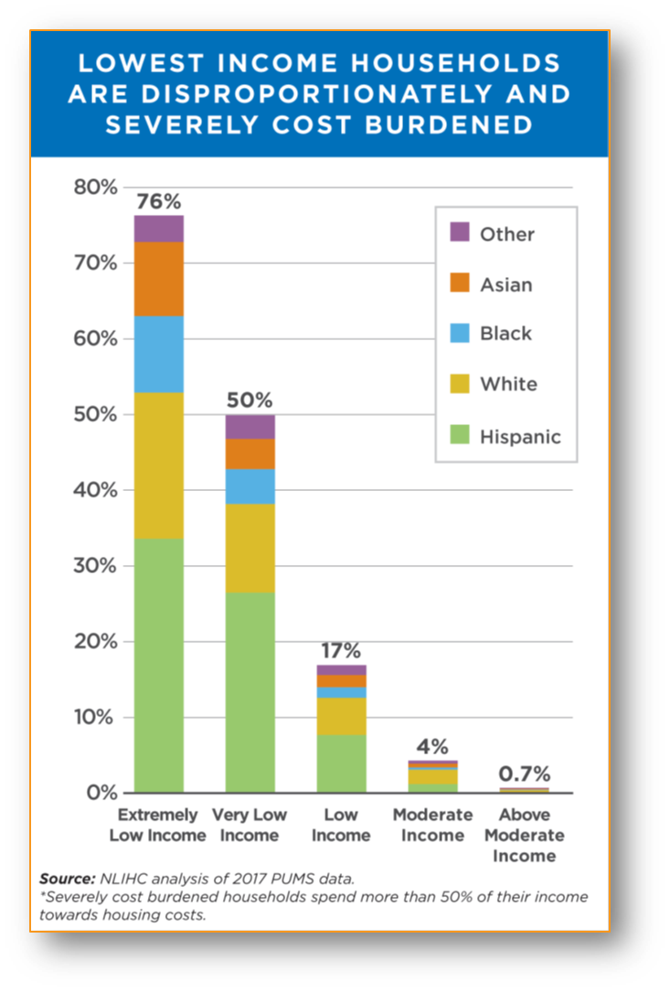
Recipe for Homelessness
Income Inequality & Severe Housing Cost Burden
Homelessness
Overcrowding & Substandard Conditions
Systemic Racism

Slide 9
Vast Majority of People with Risk Factors Do Not Become Homeless
Previous episodes of homelessness
Multiple use of services
Repeated use of services (acute care services)
UCLA Policy Lab (Dec. 2019): Target prevention to those at greatest risk based on data

Slide 10
Preventing Discharges Into Homelessness
Use Medi-Cal to pay for services to connect people to and sustain people in housing, offer housing navigation & assisted living waiver services for those with acute disabilities.
Use corrections resources to prevent discharges into homelessness through housing navigation & permanent housing.
Invest in housing and services for child-welfare-involved households experiencing homelessness, connect unaccompanied minors to CW services.
Notes:
Sharon

Slide 11
Sharon Rapport: sharon.rapport@csh.org (323) 243-7424

