Slide 1
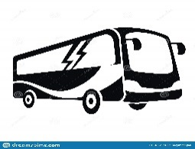
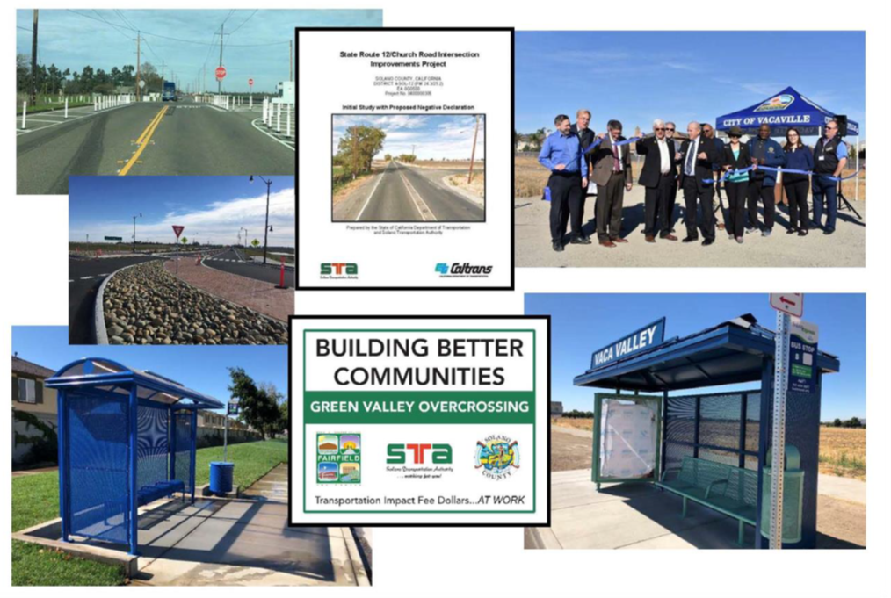



Solano County
Regional Transportation
Impact Fee (RTIF)
Presented to:
Senate Governance And Finance Committee
Senate Housing Committee
Assembly Local Government Committee
Assembly Housing And Community Development Committee
McGuire, Wiener, Aguiar-Curry, And Chiu, Chairs
on February 26, 2020

Slide 2
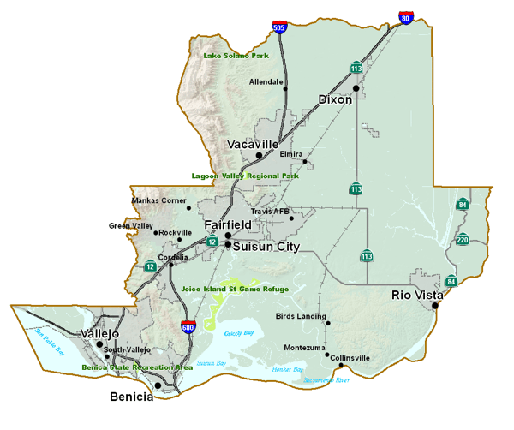
Solano Orderly Growth Initiative Background and History
1980 – The Solano Orderly Growth Initiative, evolved as the result of previous development policies approved as part of the Solano County General Plan’s Land Use and Circulation Element
1994 – The Solano Orderly Growth Initiative was officially enacted by voters to continue the County’s city-centered development policy of locating residential growth in the County’s 7 incorporated cities: Benicia, Dixon, Fairfield, Rio Vista, Suisun City, Vacaville, and Vallejo
2008 – Voters renewed the Solano Orderly Growth Initiative
2020 – As a result of this initiative, approximately 128 square miles of the County, or 14% of the total land area, lies within 7 incorporated cities
  86% of the total land area is open space, agriculture, and waterways
  95% of Solano County’s population is located within the 7 cities

Slide 3

Solano Public Facilities Fee Background and History
In January 1990, the Solano County board of supervisors passed Resolution No. 90-16 to express concern that new residential, commercial and industrial development in the county was placing increasing demands on county facilities. This resolution was jointly adopted by all of the cities in the county.
Public facilities fees are necessary to mitigate impacts caused by new development projects within the county, to finance public facilities and to assure that new development projects pay their fair share for these facilities.
Without fees from a dedicated funding source, funds for construction, expansion, or improvement of public facilities are not available to accommodate the needs caused by development projects

Slide 4






The Solano County Public Facilities Fee (PFF)
The Solano County PFF Program was adopted in 1992 and subsequently updated in 1998, 2002, 2007, 2013, and 2018.
The fee for new development in the incorporated area is collected by a respective City or by the County for development in the unincorporated area.
Courthouse Project
Health &
Social Services
Headquarters Building
AB900 Stanton Correctional Facility
Solano County Animal Care Facility
Solano PFF Revenue Funded

Slide 5
Types of Facilities Included in the Solano Public Facilities Fee (PFF)
Facility Category | List of Facilities Included
Public Protection (Includes Courts) | Sheriff; Adult detention, Inmate training, and Probation facilities; Courts (Traffic, Juvenile Detention, Collaborative); DA forensic lab improvements/equipment, Animal Care facilities, Fair-share debt service on Gov. Administrative Center
Health and Social Services | Healthcare facilities (regional/Countywide facilities, including behavioral and mental health facilities), Capital equipment, Office space
Library | Library expansions and six new branch libraries
General Government | General Services facilities; Ag. Commissioner office space and equipment; County Parks improvements; Capital equipment for elections; IT improvements in required facilities; Fair-share debt service on Gov. Administrative Center
Transportation (Added 2014) | Regional roads and road improvements (STA); County roads; Transit projects

Slide 6
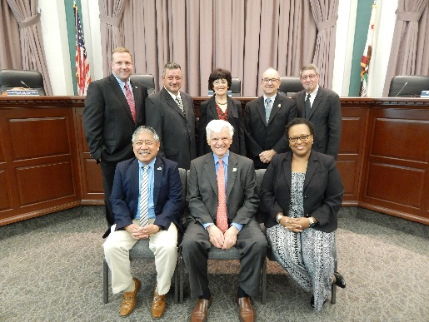

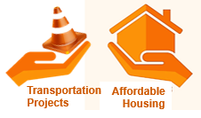
The Regional Transportation Impact Fee (RTIF)
In 2013, the STA Board (which is comprised of 7 Solano Mayors and 1 County Supervisor) requested that the County add transportation impacts to the Public Facilities Fee
The RTIF began in February 2014 as a way to mitigate the impacts of development on transportation
It is a portion of the existing PFF dedicated to transportation impacts – not an additional fee
Seven working groups of local agency representatives were created to select RTIF projects
Averages $1.2M annually at $1,500 per unit
  A 2013 Nexus Study found that Solano County could justify charging up to $8,282 per Single Family dwelling unit to mitigate the impacts of development
The RTIF Program is governed and administered by STA
$1500 per dwelling
unit

Slide 7
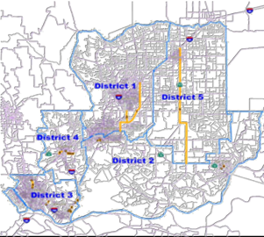
Regional Transportation
Impact Fee (RTIF) Working Groups
Each RTIF District has its own Working Group to strategize, prioritize, plan, and deliver projects
Each Group includes one or more cities and the County, facilitating regional collaboration on transportation projects
90% of the RTIF Revenue collected is allocated back to the cities based on 5 geographical areas where development occurs

Slide 8
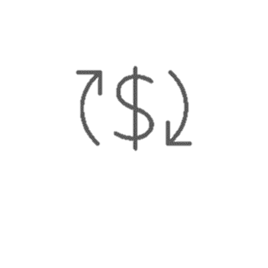


Regional Transportation
Impact Fee (RTIF) Distribution
90% of the RTIF Revenue collected is allocated back to the 7 incorporated cities
5% of the RTIF Revenue collected is allocated toward regional transit
5% of the RTIF Revenue collected is allocated toward unincorporated County roads impacted by development

Slide 9
RTIF Revenue by District
RTIF Revenue for Eligible Projects |  | Total Revenue Collected 2014-Present
District 1 Jepson Corridor |  | $3,462,220
District 2 SR 12 Corridor |  | $660,429
District 3 South County |  | $294,882
District 4 Central County |  | $1,367,642
District 5 SR 113 |  | $591,205
District 6 Regional Transit (5%) |  | $354,243
District 7 County Road (5%) |  | $354,243
Total RTIF Revenue Collected |  | $7,084,865

Slide 10



RTIF Program Successes
Collected over $7M in 6 years of the program
7 projects or phases have been completed using RTIF funds
3 projects are currently underway
Estimated $39M leveraged in regional and state funding
In 2018, Solano County increased the RTIF component of the PFF from $1500 to $2500 per unit, without raising the overall PFF

Slide 11
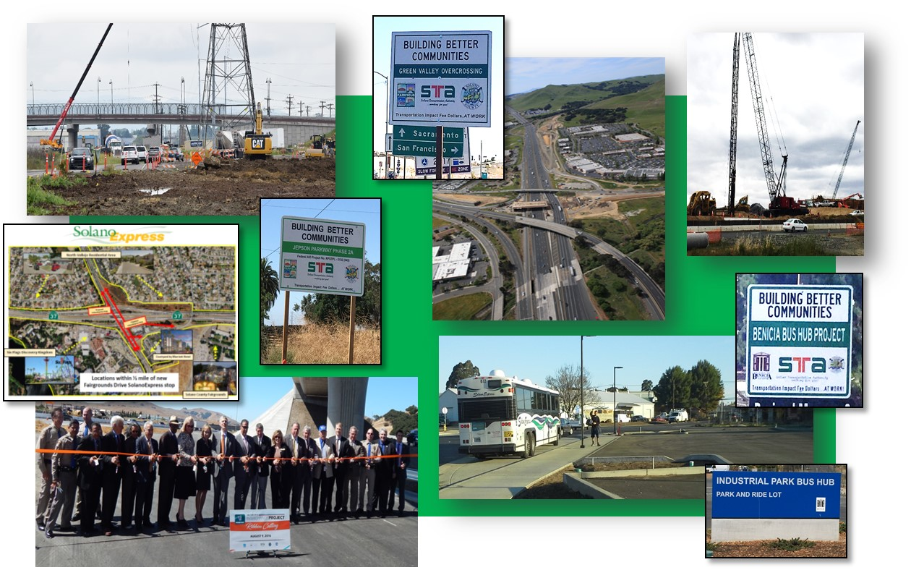
Projects Advanced With RTIF Funding (Completed)
Jepson Parkway Phase 1A (Vacaville)
Midway Rd Safety Improvements (County/Dixon)
Benicia Bus Hub (Benicia)
Green Valley Overcrossing (Fairfield)
SolanoExpress Bus Stops at Solano Community College (Fairfield)
Church Rd Intersection Environmental (Rio Vista)
Fairgrounds Dr. SolanoExpress Bus Stops (Vallejo)

Slide 12
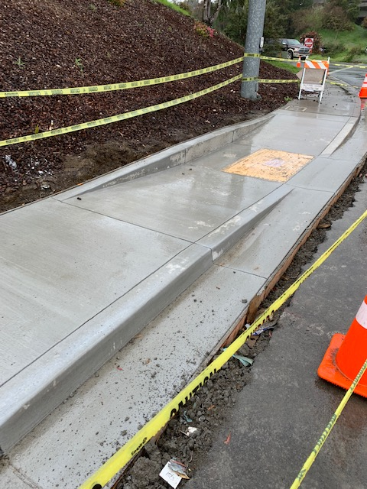
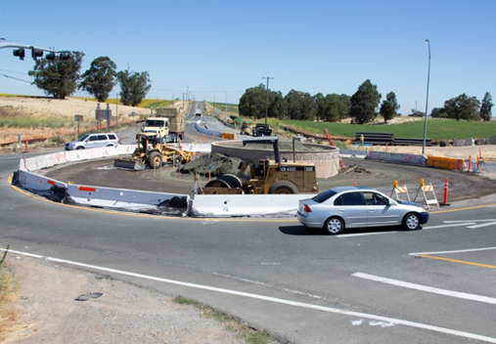
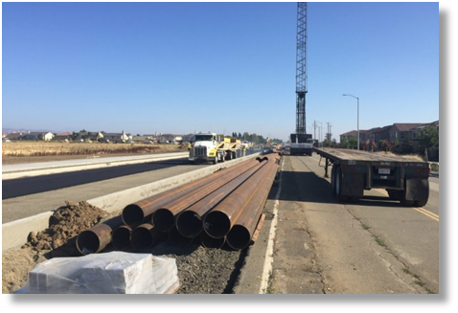
Projects Advanced With RTIF Funding (In Progress)
Jepson Parkway Phase 1B (Vacaville)
Jepson Parkway Phase 2A (Fairfield)
SR 12 Complete Streets Project (Rio Vista)

Slide 13
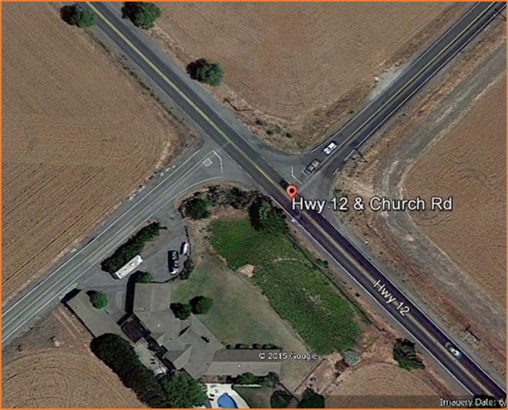
Case Study
Church Rd Intersection Environmental
  Total Cost Estimate: $4.5M
  Safety and operations project to provide access to development
  ENV Document ($300k) funded through RTIF in 2018
  Caltrans agreed to STA’s request to include the Church Rd project in larger SR12 SHOPP project because project was ready for design
  $300,000 Solano RTIF investment resulted in more than $4M in leveraging.
Offset intersection with no turn lanes

Slide 14
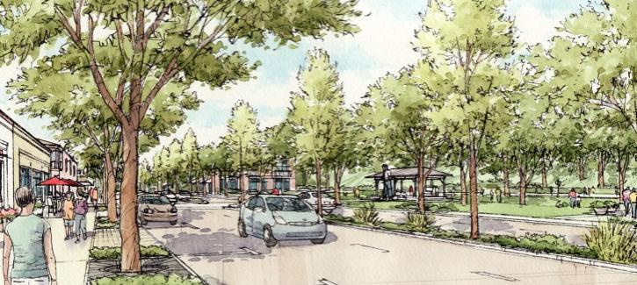
Future RTIF Priorities
Advance projects to make them competitive for grant funding for construction
Leverage RTIF funding for regional and state grant match
Focus on projects that foster housing production, particularly affordable housing, job growth, and improved safety
Promote investment in Priority Development Areas (PDAs) with access to regional transit connectivity

Slide 15

For questions regarding the…
Presentation:
Daryl Halls, Executive Director
Solano Transportation Authority
dkhalls@sta.ca.gov | (707) 424-6075
Solano RTIF Program:
Erika McLitus, Project Assistant
Solano Transportation Authority
emclitus@sta.ca.gov | (707) 424-6075

