Slide 1
Housing and Homelessness in California
Christopher Martin
Legislative Advocate, Homelessness
Notes:
Chris

Slide 2
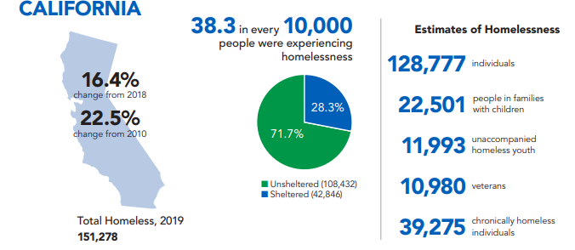

Slide 6
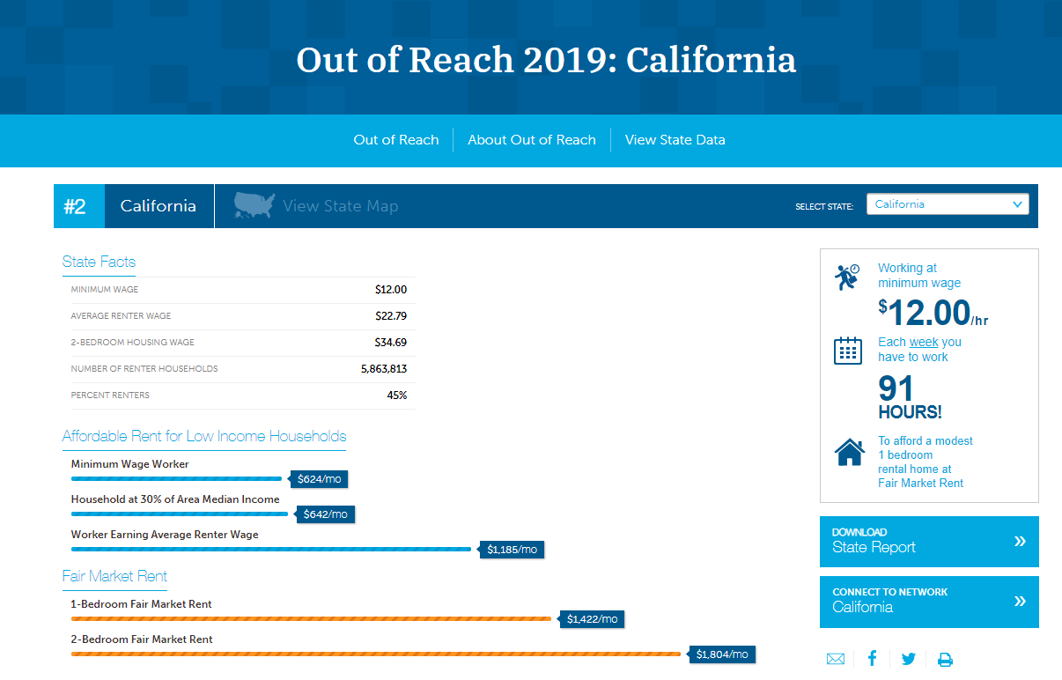

Slide 7
